Slide 1
CSCE 3110 Data Structures & Algorithms
Priority Queues
Heaps
HeapSort
Reading: Weiss, chap. 6

Slide 2
Content
Priority Queues
Heaps
Heapsort

Slide 3
Priority Queue ADT
Priority Queue is an extension of queue with following properties:
Entries consist of key (priority) and value.
Entries in priority queue are ordered by key
An entry with high key is dequeued before an element with low key.
If two entries have the same key, they are served according to their order in the queue (FIFO for same priority)..

Slide 4
Priority Queue ADT
A typical priority queue supports following operations:
insert(key, value): Inserts an item with given key.
min/max(): Returns the smallest/largest key item.
removemin/removemax(): Removes the smallest/largest key item.

Slide 5
Applications of Priority Queues
Event/job management
assigns priority to events/jobs
In Operating Systems
Scheduling jobs, like hardware interrupts. Higher-priority processes are given preference in CPU scheduling.
In Simulators
Scheduling the next event (smallest event time). This helps in time-based simulations, where events are processed in the order of their occurrence.
If you have a priority queue with these key-value pairs:
(1, "Task A")
(5, "Task B")
(3, "Task C")
(7, "Task D")
The min-priority queue would dequeue them in this order based on their keys:
"Task A" (key = 1)
"Task C" (key = 3)
"Task B" (key = 5)
"Task D" (key = 7)

Slide 6
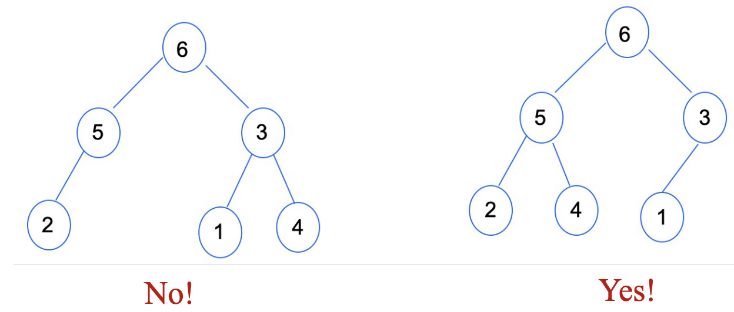
Heap
Tree-based data structure
A complete tree
every level is filled, except possibly the last, and all nodes filled from left to right as much as possible.
Satisfies the heap property:
Max-Heap: If P is the parent node of C, then the key of P is greater than or equal to the key of C. In this case, the largest element is at the root.
Min-Heap: If P is the parent node of C, then the key of P is less than or equal to the key of C. Here, the smallest element is at the root.

Slide 7
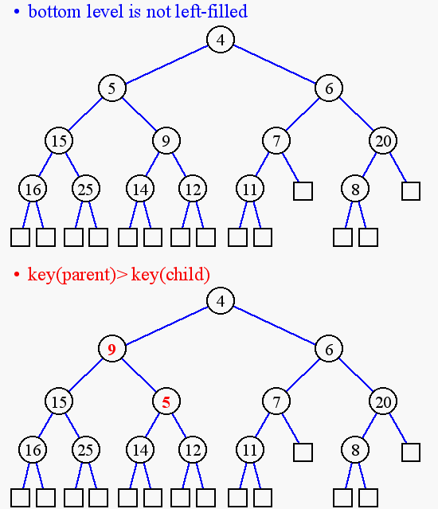
Heap or Not a Heap? (min heap)

Slide 8
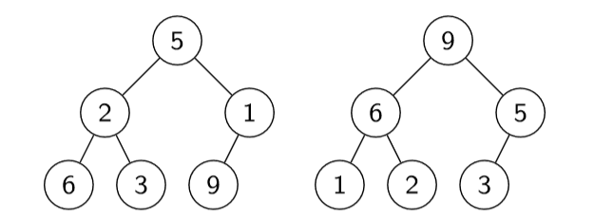
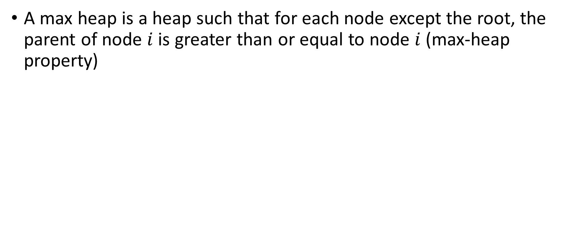
Heaps – max heap
A max heap is a heap such that for each node except the root, the parent of node $i$ is greater than or equal to node $i$ (max-heap property)
Where is the largest element?
Where is the smallest element?

Slide 9
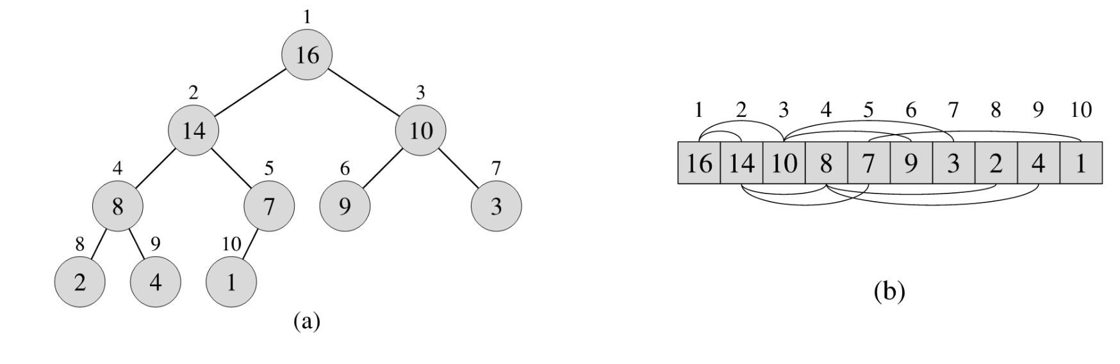
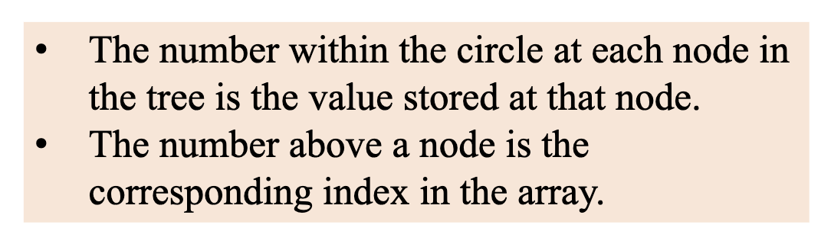
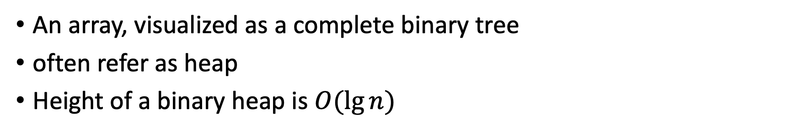
Binary Heap & Array
An array, visualized as a complete binary tree
often refer as heap
Height of a binary heap is $O(lg⁡n)$

Slide 10
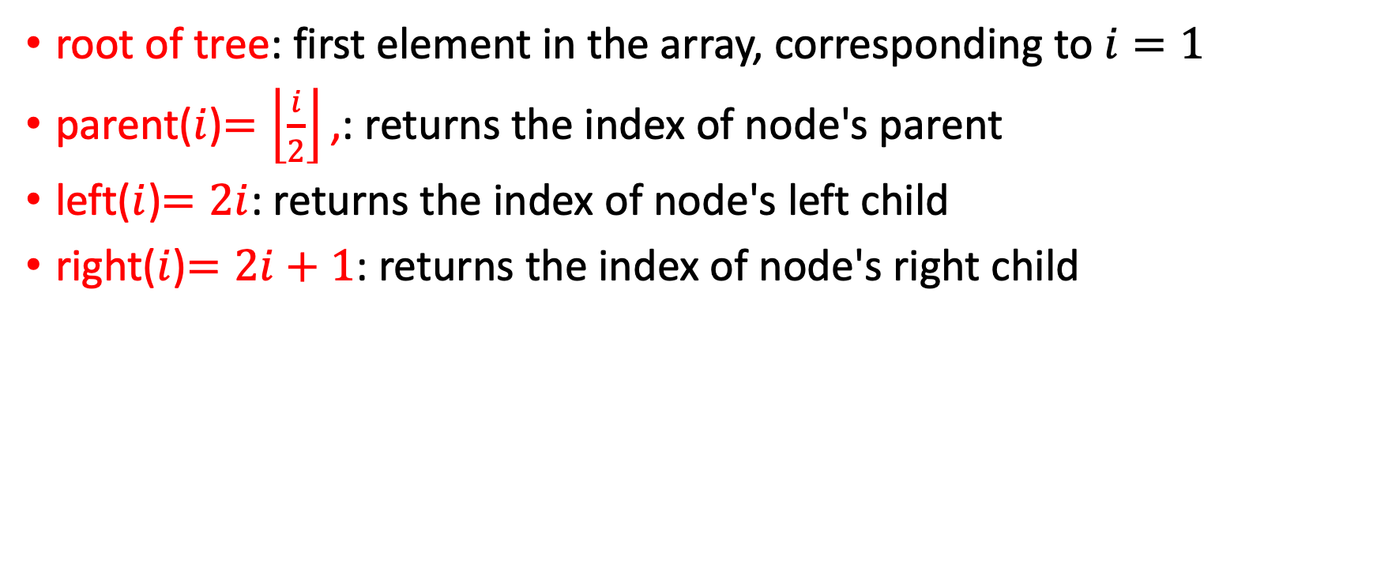
Heap as a Tree
root of tree: first element in the array, corresponding to $i=1$
parent($i$)$=\left\lfloor \frac{i}{2}\right\rfloor \text{,}$: returns the index of node's parent
left($i$)$=2i$: returns the index of node's left child
right($i$)$=2i+1$: returns the index of node's right child
How much do these operations cost?
constant time O(1).

Slide 11
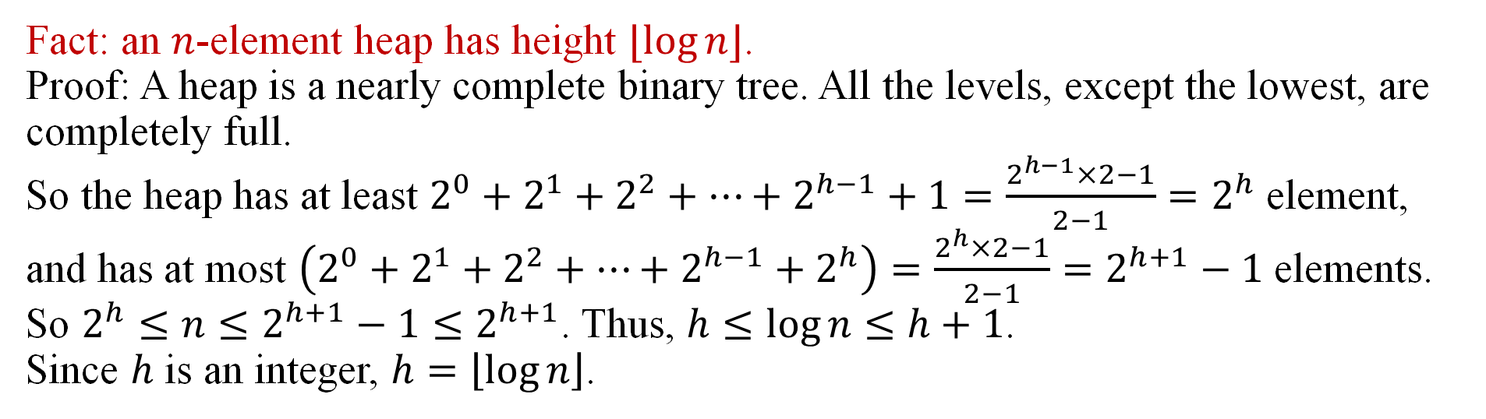
Height of Heap
The height of a node in a tree is the number of edges on the longest simple downward path from the node to a leaf.
The height of a tree is the height of its root.
Fact: an $n$-element heap has height $⌊log⁡n⌋$.
Proof: A heap is a nearly complete binary tree. All the levels, except the lowest, are completely full.
So the heap has at least $2^{0}+2^{1}+2^{2}+…+2^{h−1}+1=\frac{2^{h−1}×2−1}{2−1}=2^{h}$ element, and has at most $\left(2^{0}+2^{1}+2^{2}+…+2^{h−1}+2^{h}\right)=\frac{2^{h}×2−1}{2−1}=2^{h+1}−1$ elements.
So $2^{h}≤n≤2^{h+1}−1≤2^{h+1}$. Thus, $h≤\log{n}≤h+1$.
Since $h$ is an integer, $h=\left\lfloor \log{n}\right\rfloor$.

Slide 12
True or False
The maximum item in the min heap must be at one of the leaves.
To ﬁnd the maximum item in the min heap, every leaf must be examined.

Slide 13
Heap Operations
For max heap:
max: return the maximum item
extract_max: return and remove the maximum item
build_max_heap: produce a max-heap from an unordered array
max_heapify: correct a single violation of the heap property in a subtree at its root
Insert : inserts a new element into the heap, adjusted to restore the heap property.
heapsort : a sorting algorithm that first builds a max-heap

Slide 14
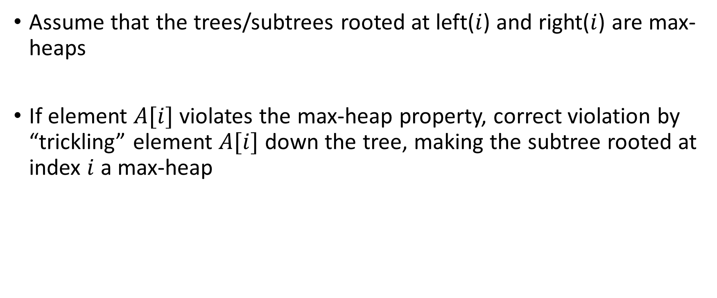
max_heapify
Assume that the trees/subtrees rooted at left($i$) and right($i$) are max-heaps
If element $A[i]$ violates the max-heap property, correct violation by “trickling” element $A[i]$ down the tree, making the subtree rooted at index $i$ a max-heap

Slide 15
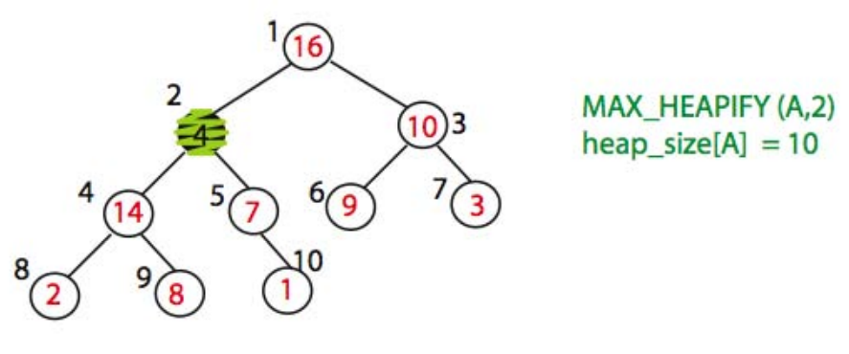
max_heapify (Example)

Slide 16
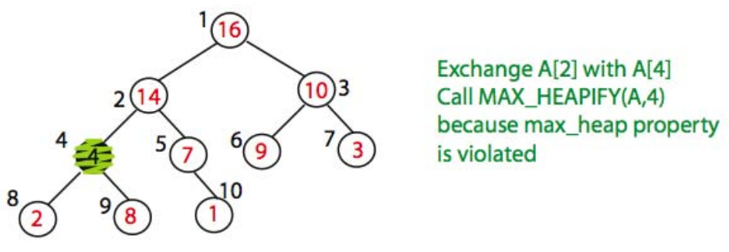
max_heapify (Example)

Slide 17
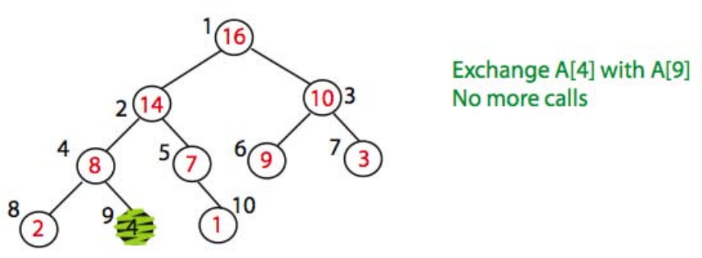
max_heapify (Example)
Time=?

Slide 18
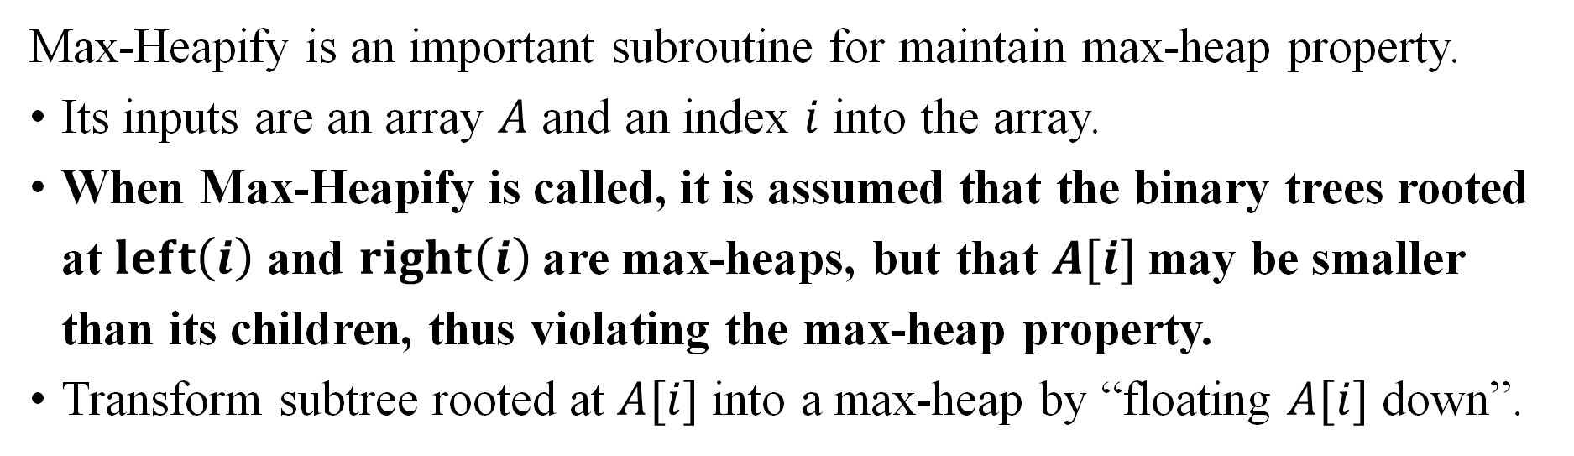
Max-Heapify - idea
Max-Heapify is an important subroutine for maintain max-heap property.
Its inputs are an array $A$ and an index $i$ into the array.
When Max-Heapify is called, it is assumed that the binary trees rooted at $left\left(i\right)$ and $right\left(i\right)$are max-heaps, but that $A[i]$may be smaller than its children, thus violating the max-heap property.
Transform subtree rooted at $A[i]$ into a max-heap by “floating $A[i]$ down”.
Notes:
There ar e2 issues concerning algorithms: correctness and efficiency.

Slide 19
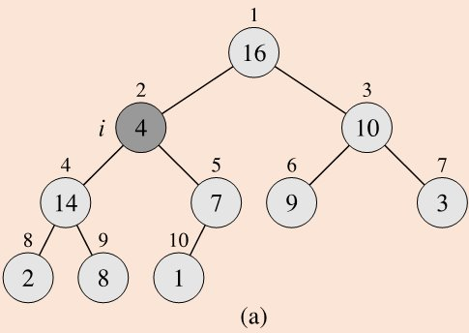
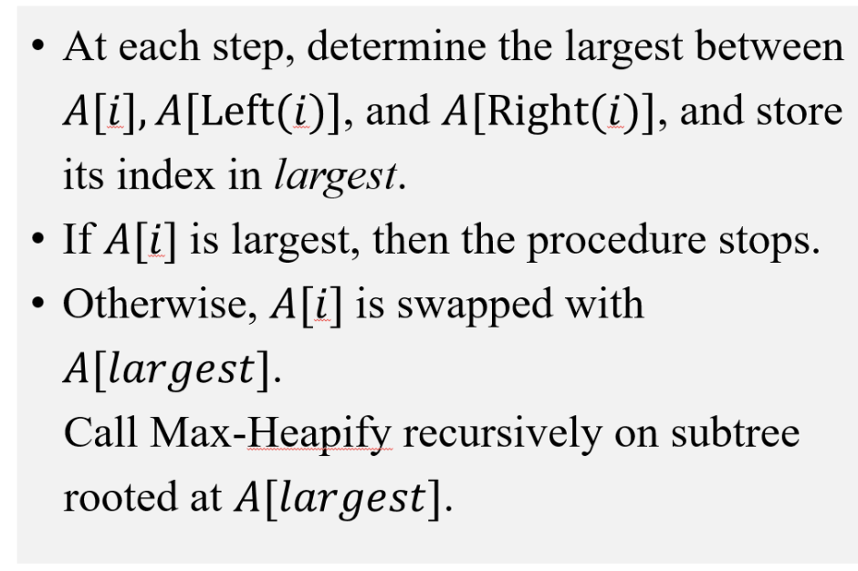
max_heapify Pseudocode
max_heapify(A, i):
l = left(i)
r = right(i)
if (l <= heap-size(A) and A[l] > A[i])
then largest = l else largest = i
if (r <= heap-size(A) and A[r] > A[largest])
then largest = r
if largest != i
then exchange A[i] and A[largest]
max_heapify(A, largest)

Slide 20
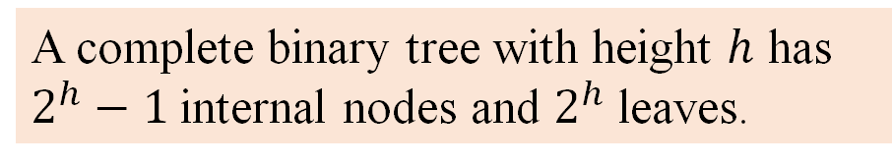
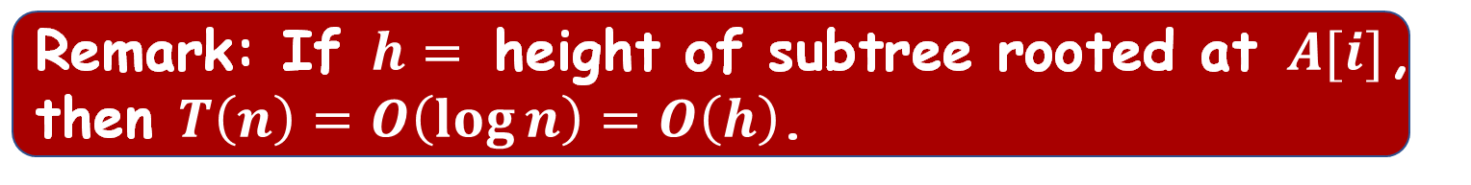
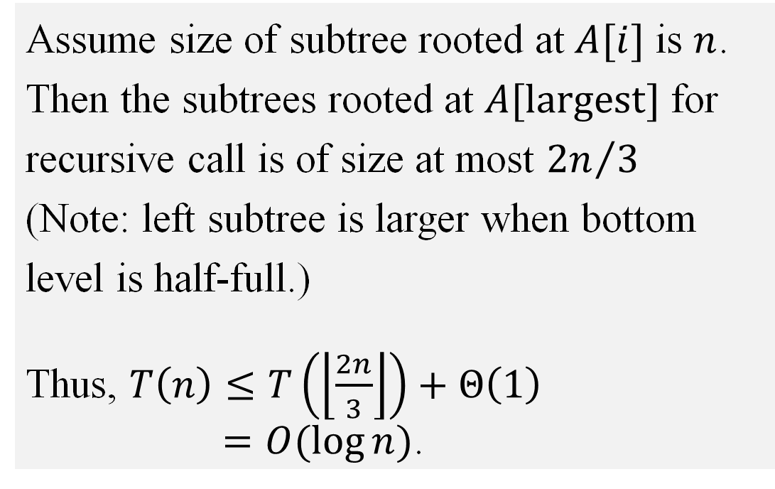
Max-Heapify - complexity
A complete binary tree with height $h$ has $2^{h}−1$ internal nodes and $2^{h}$ leaves.
Complexity of Max-Heapify
Assume size of subtree rooted at $A[i]$ is $n$.
Then the subtrees rooted at $A[largest]$ for recursive call is of size at most ${2n}/3$
(Note: left subtree is larger when bottom level is half-full.)
Thus, $T\left(n\right)≤T\left(\left\lfloor \frac{2n}{3}\right\rfloor \right)+Θ\left(1\right)$
$=O(\log{n})$.
Remark: If $h=$ height of subtree rooted at $A[i]$, then $T\left(n\right)=O\left(\log{n}\right)=O\left(h\right)$.

Slide 21
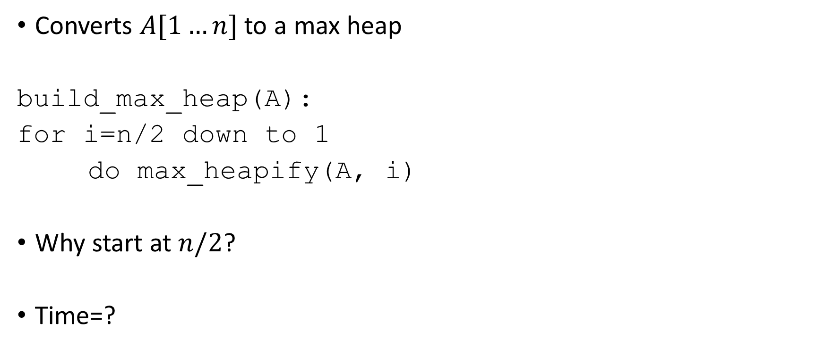
build_max_heap(A)
Converts $A[1…n]$ to a max heap
build_max_heap(A):
for i=n/2 down to 1
do max_heapify(A, i)
Why start at $n/2$?
Time=?

Slide 22
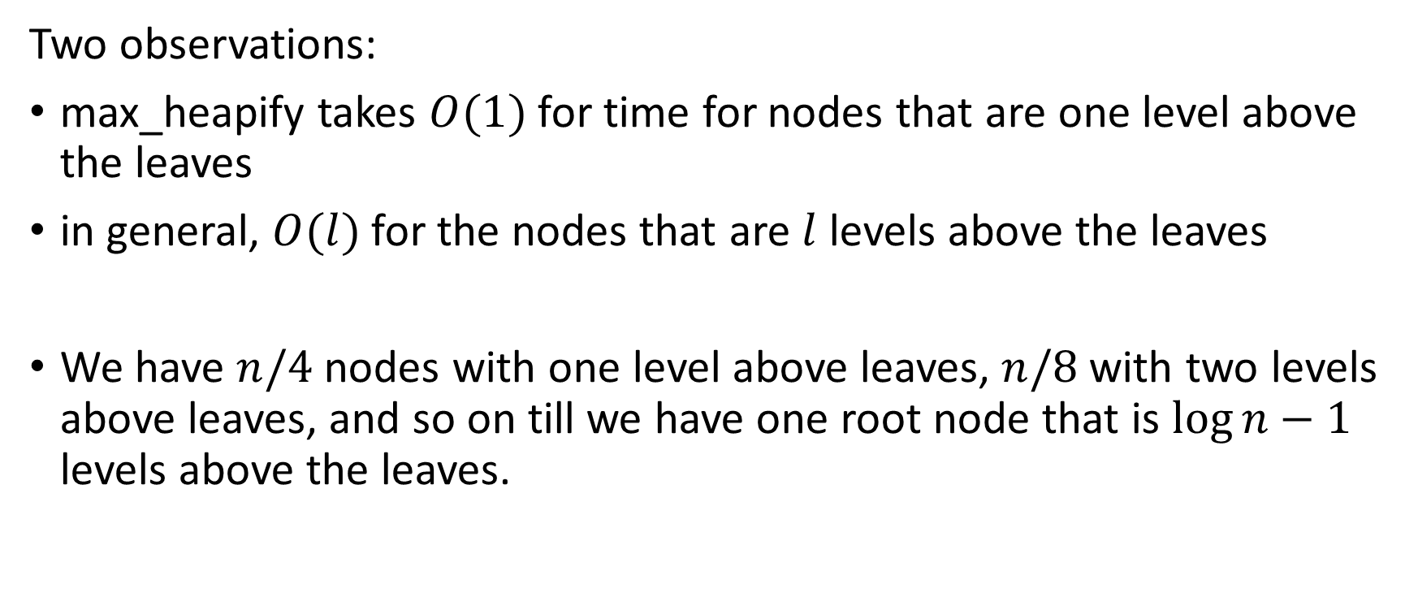
build_max_heap(A) Analysis
Two observations:
max_heapify takes $O(1)$ for time for nodes that are one level above the leaves
in general, $O(l)$for the nodes that are $l$ levels above the leaves
We have $n/4$nodes with one level above leaves, $n/8$with two levels above leaves, and so on till we have one root node that is $\log{n}−1$ levels above the leaves.

Slide 23
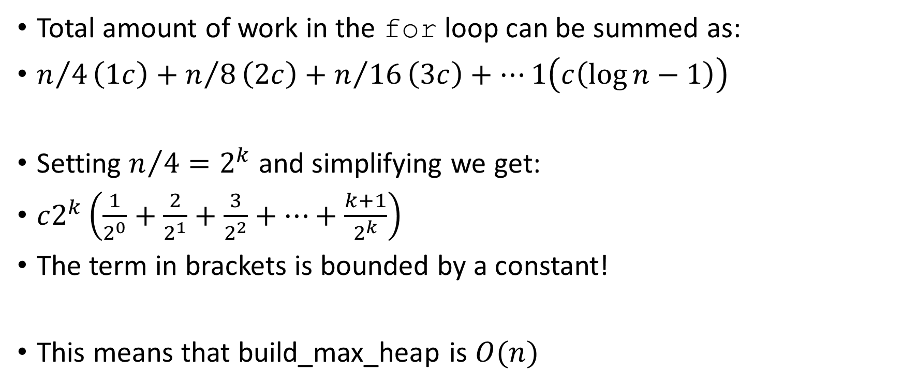
build_max_heap(A) Analysis
Total amount of work in the for loop can be summed as:
$n/4\left(1c\right)+n/8\left(2c\right)+n/{16}\left(3c\right)+⋯1\left(c\left(\log{n}−1\right)\right)$
Setting $n/4=2^{k}$ and simplifying we get:
$c2^{k}\left(\frac{1}{2^{0}}+\frac{2}{2^{1}}+\frac{3}{2^{2}}+⋯+\frac{k+1}{2^{k}}\right)$
The term in brackets is bounded by a constant!
This means that build_max_heap is $O(n)$

Slide 24
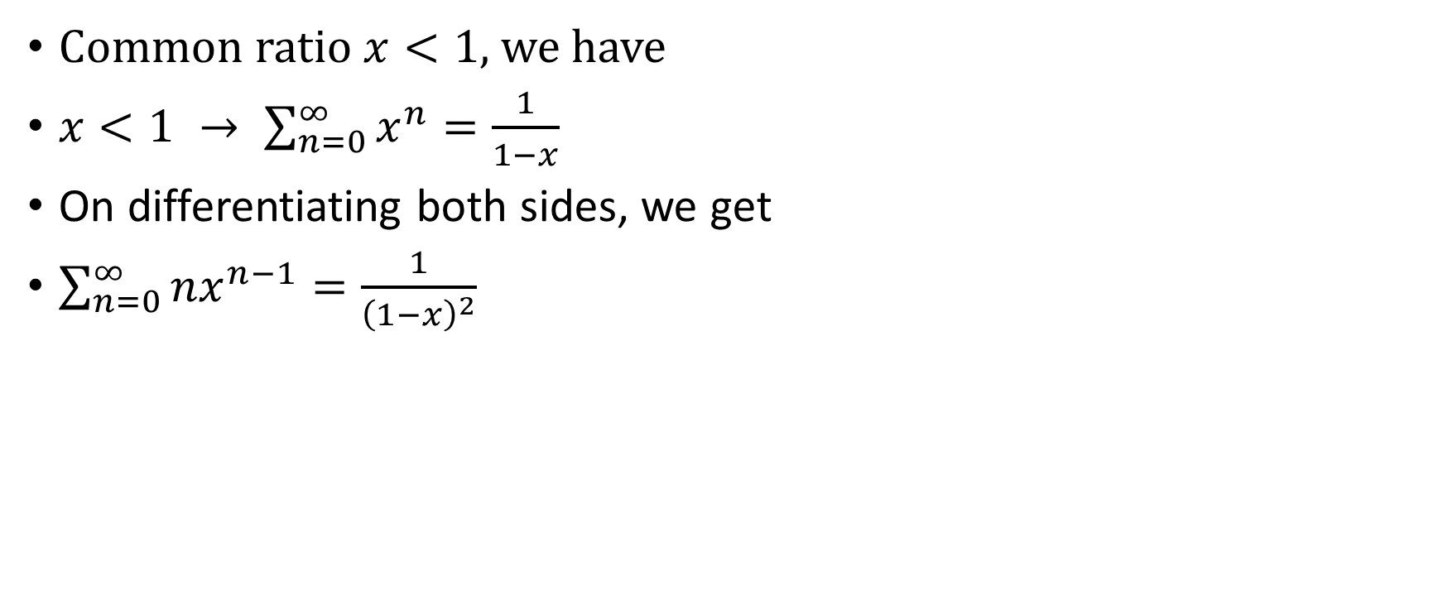
Common ratio $x<1$, we have
$x<1 → \sum_{n=0}^{∞}{x^{n}}=\frac{1}{1−x}$
On differentiating both sides, we get
$\sum_{n=0}^{∞}{nx^{n−1}}=\frac{1}{{\left(1−x\right)}^{2}}$

Slide 25
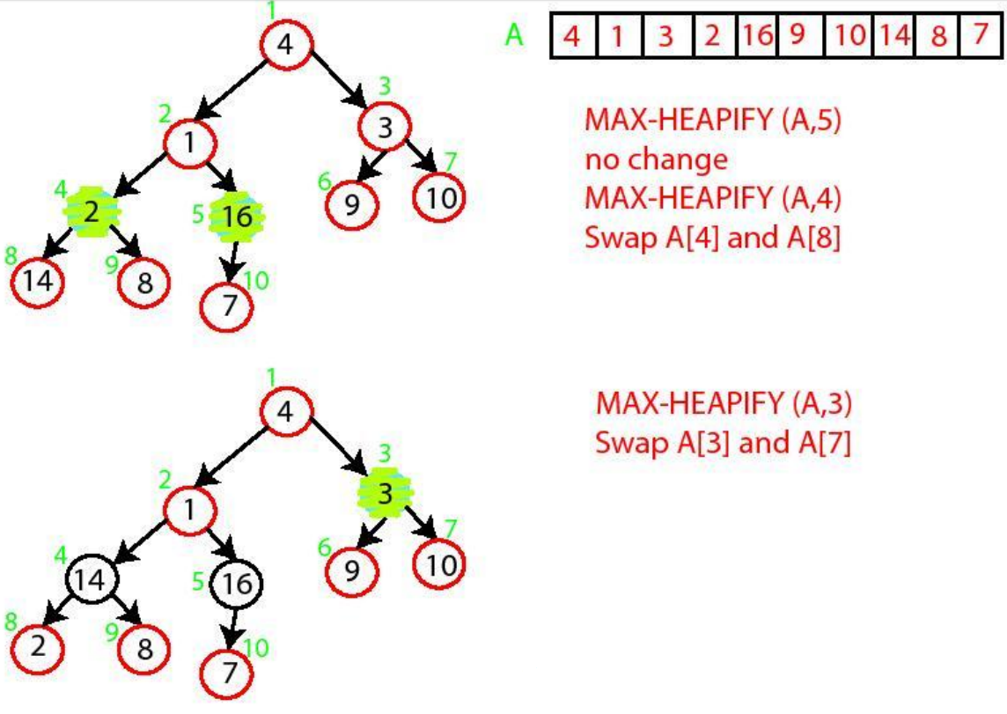
build_max_heap Demo

Slide 26
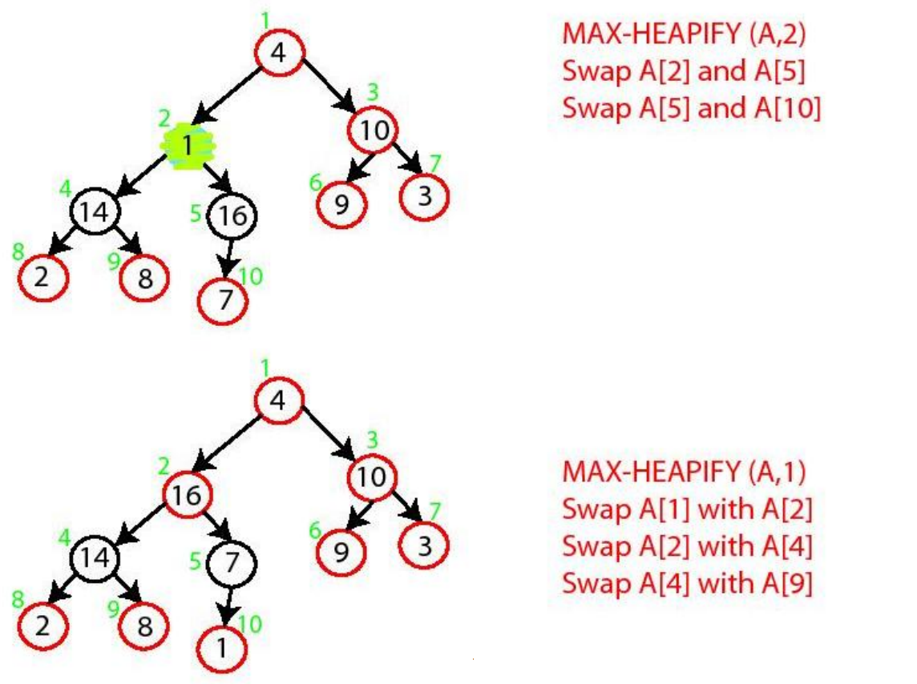
build_max_heap Demo

Slide 27
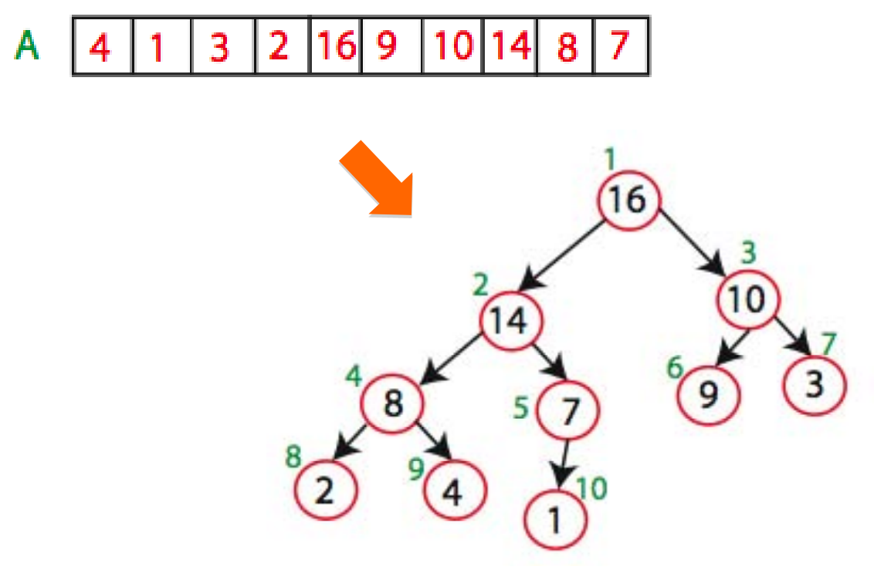
build_max_heap

Slide 28
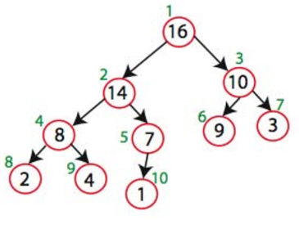
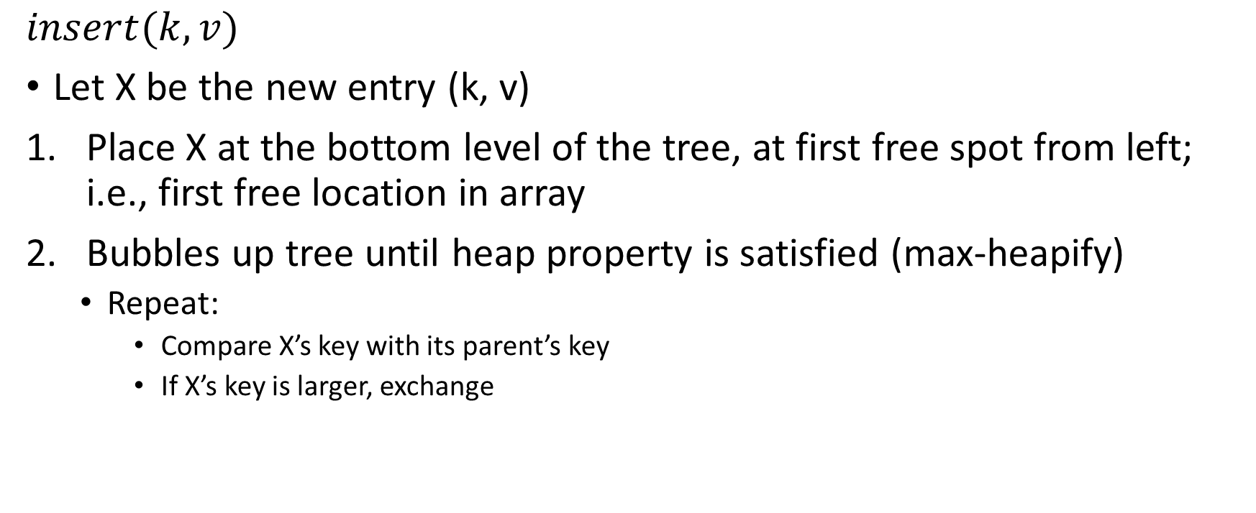
Insert
$$insert(k, v)$$
Let X be the new entry (k, v)
Place X at the bottom level of the tree, at first free spot from left; i.e., first free location in array
Bubbles up tree until heap property is satisfied (max-heapify)
Repeat:
Compare X’s key with its parent’s key
If X’s key is larger, exchange

Slide 29
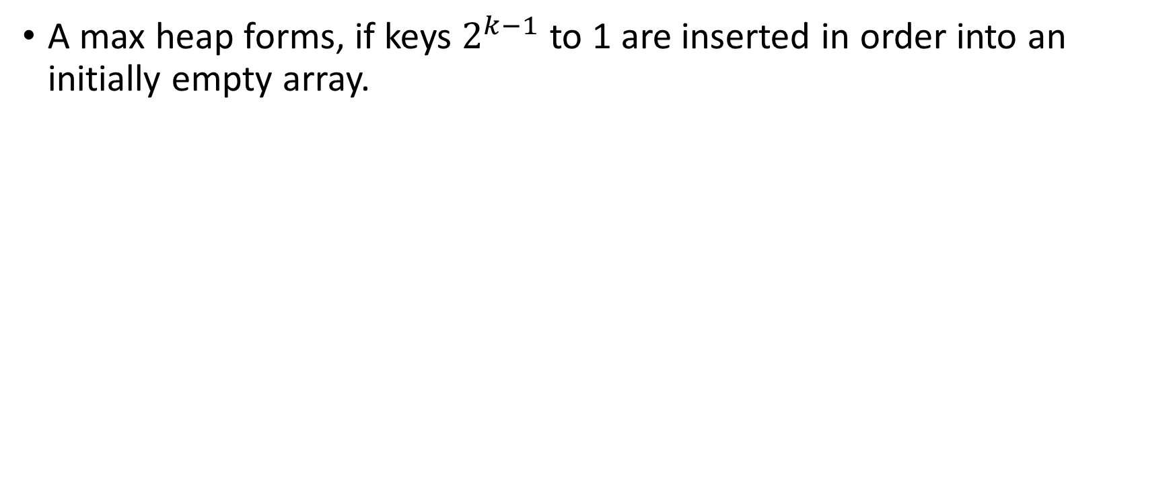
True or False
A max heap forms, if keys $2^{k−1}$ to 1 are inserted in order into an initially empty array.

Slide 30
max
Return entry at root

Slide 31
extract_max
Return and remove entry at root
Save item at root for return value
Fill root with last item “X” in tree
Bubble “X” down the heap (max-heapify)
Repeat: If X > one or both of its children, swap X with its maximum child

Slide 32
Running times
 | Binary heap | Sorted List | Unsorted List
max()
insert()
worst-case
best-case
extract_max()
worst-case
best-case

Slide 33
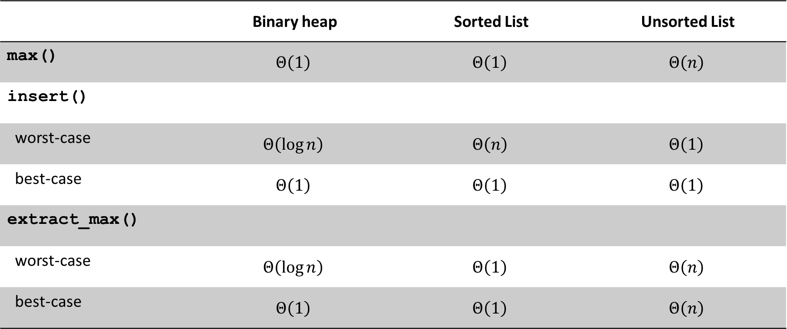
Running times
 | Binary heap | Sorted List | Unsorted List
max() | $$Θ\left(1\right)$$ | $$Θ\left(1\right)$$ | $$Θ\left(n\right)$$
insert()
worst-case | $$Θ\left(\log{n}\right)$$ | $$Θ\left(n\right)$$ | $$Θ\left(1\right)$$
best-case | $$Θ\left(1\right)$$ | $$Θ\left(1\right)$$ | $$Θ\left(1\right)$$
extract_max()
worst-case | $$Θ\left(\log{n}\right)$$ | $$Θ\left(1\right)$$ | $$Θ\left(n\right)$$
best-case | $$Θ\left(1\right)$$ | $$Θ\left(1\right)$$ | $$Θ\left(n\right)$$

Slide 34
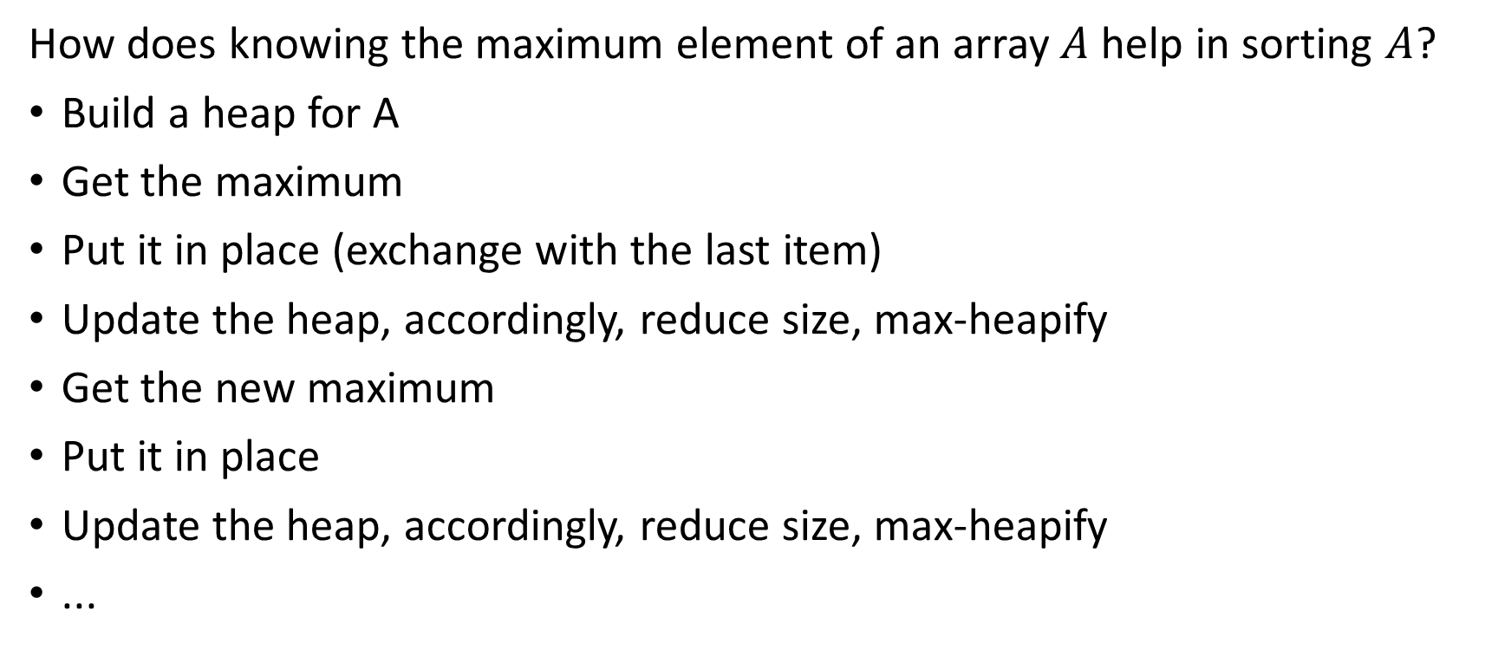
Heapsort
How does knowing the maximum element of an array $A$ help in sorting $A$?
Build a heap for A
Get the maximum
Put it in place (exchange with the last item)
Update the heap, accordingly, reduce size, max-heapify
Get the new maximum
Put it in place
Update the heap, accordingly, reduce size, max-heapify
...

Slide 35
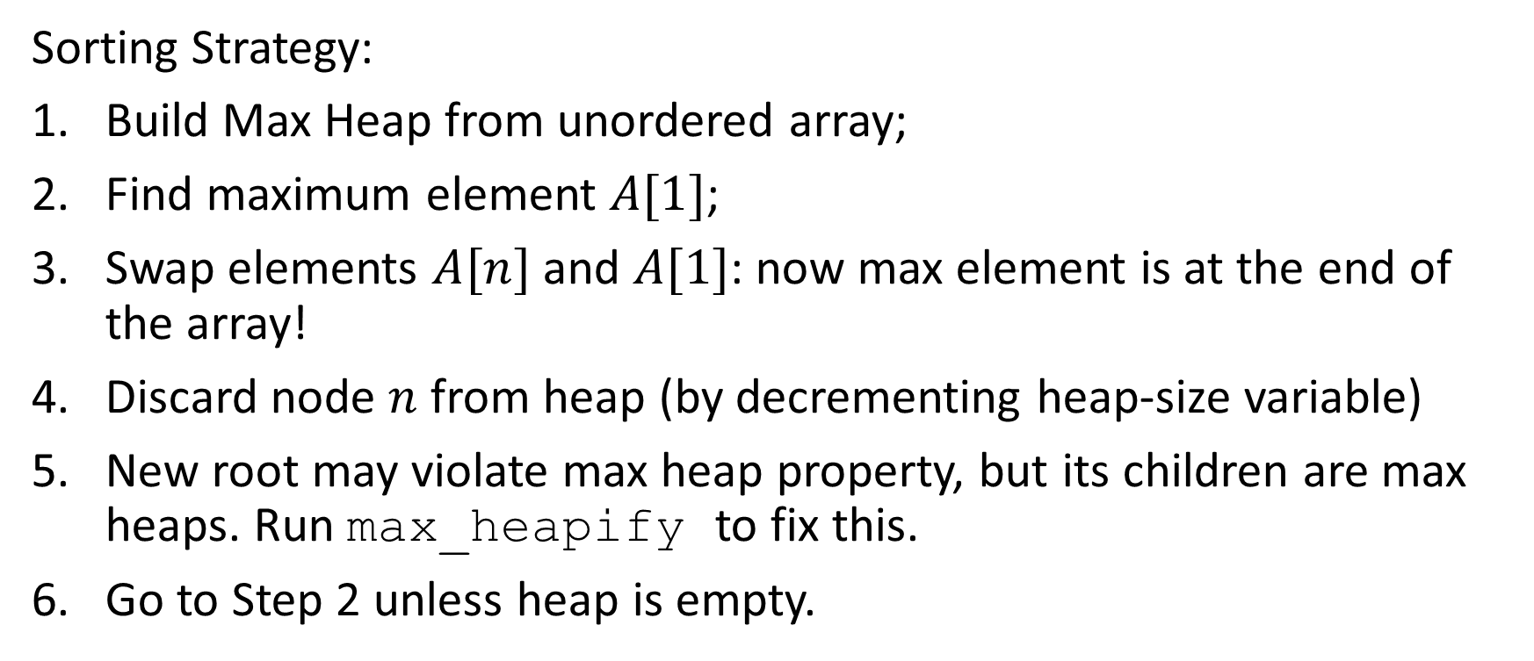
Heapsort
Sorting Strategy:
Build Max Heap from unordered array;
Find maximum element $A[1]$;
Swap elements $A[n]$ and $A[1]$: now max element is at the end of the array!
Discard node $n$ from heap (by decrementing heap-size variable)
New root may violate max heap property, but its children are max heaps. Run max_heapify to fix this.
Go to Step 2 unless heap is empty.

Slide 36
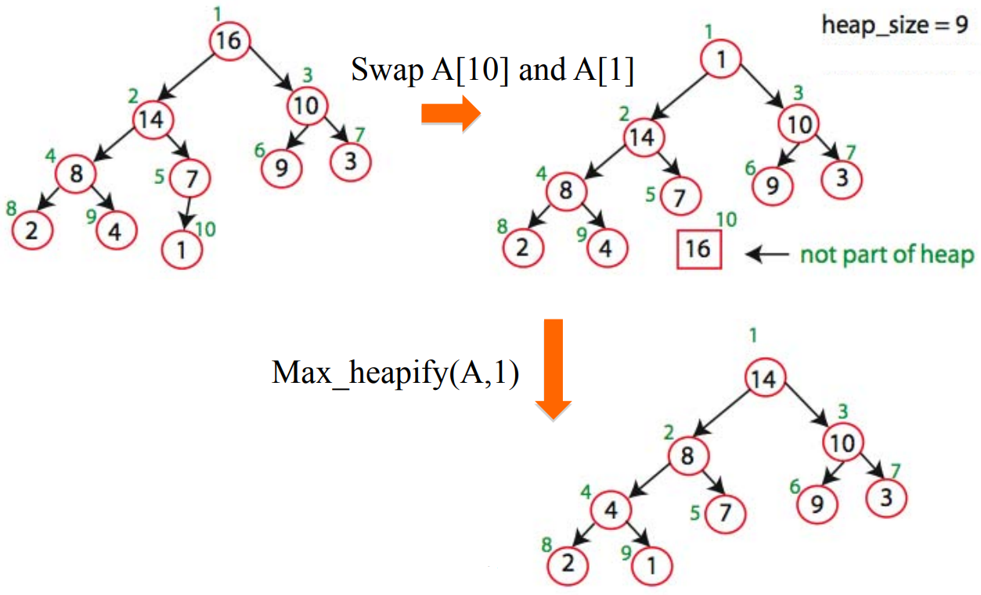
Heapsort Demo

Slide 37
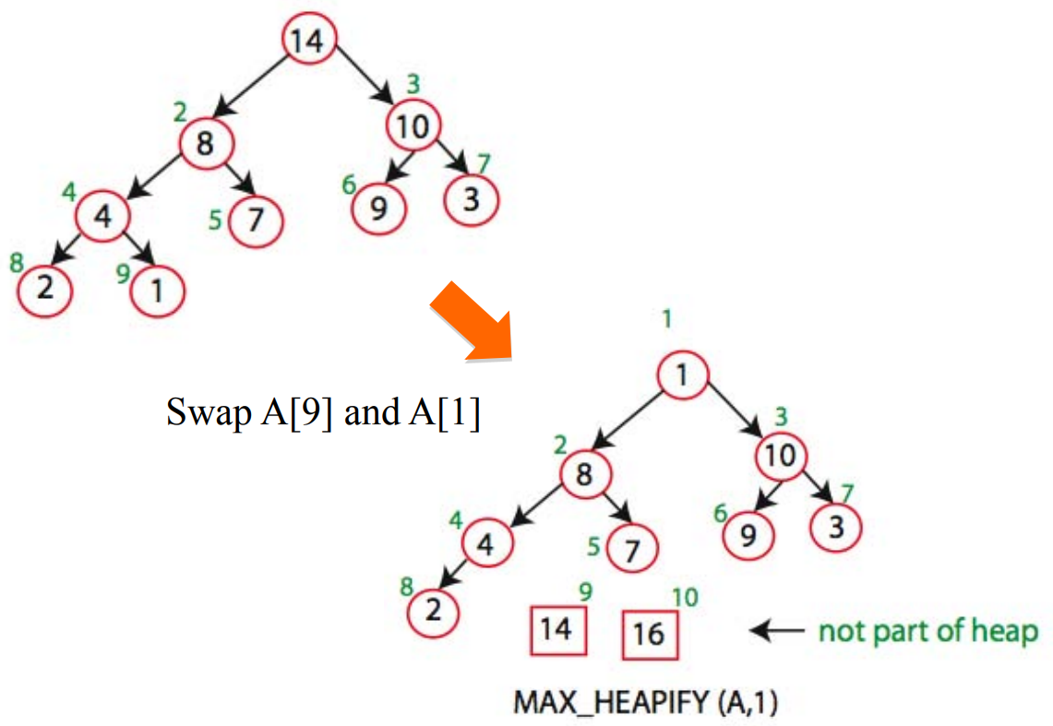
Heapsort Demo

Slide 38
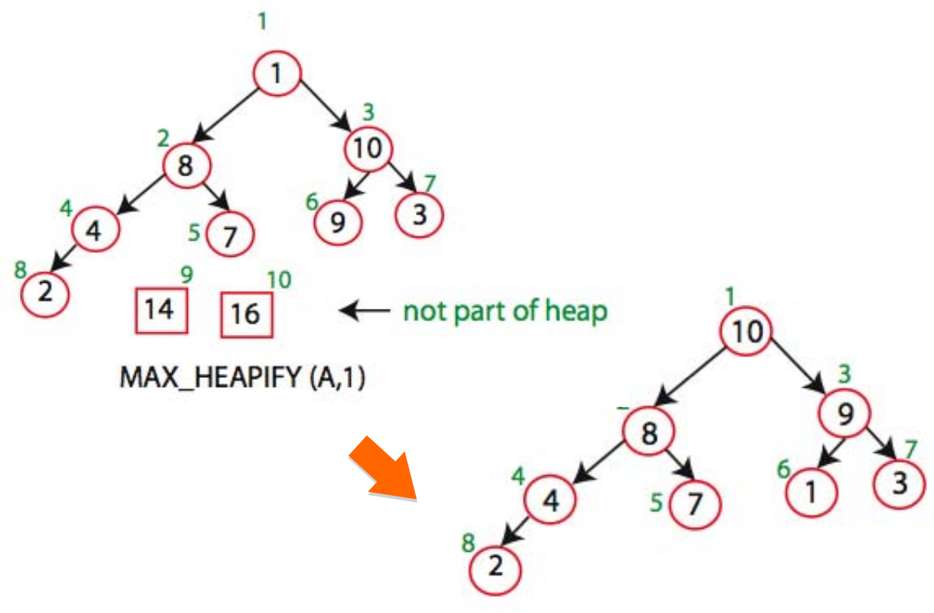
Heapsort Demo

Slide 39
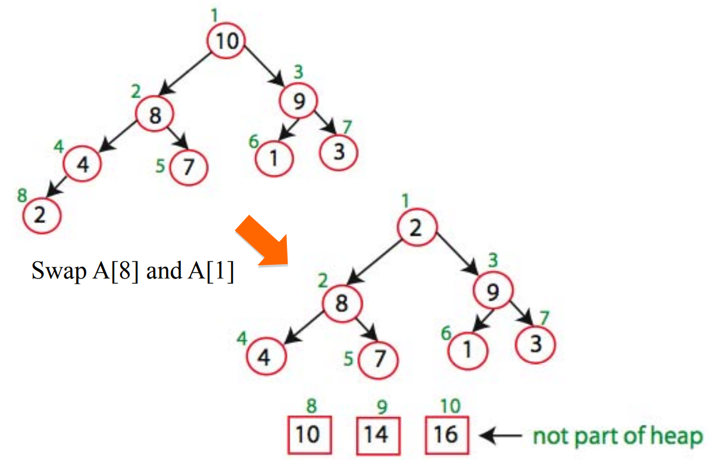
Heapsort Demo

Slide 40
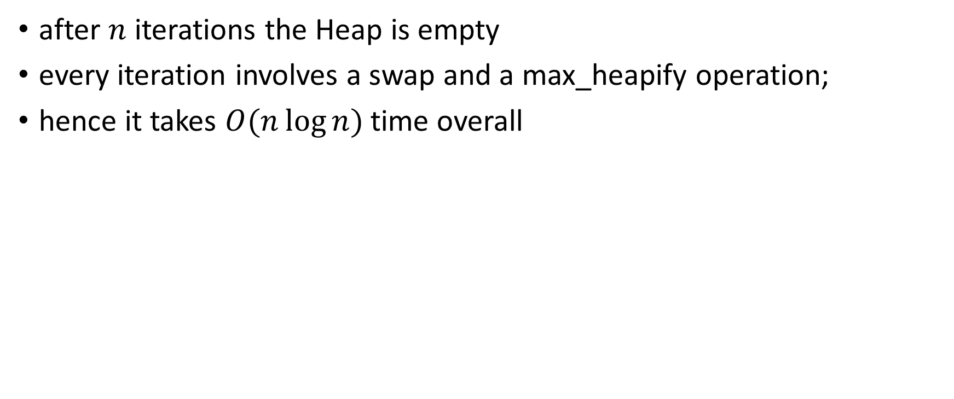
Heapsort Running time
after $n$ iterations the Heap is empty
every iteration involves a swap and a max_heapify operation;
hence it takes $O(n\log{n})$time overall

